Slide 1
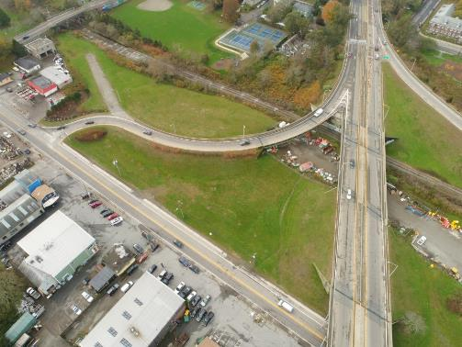
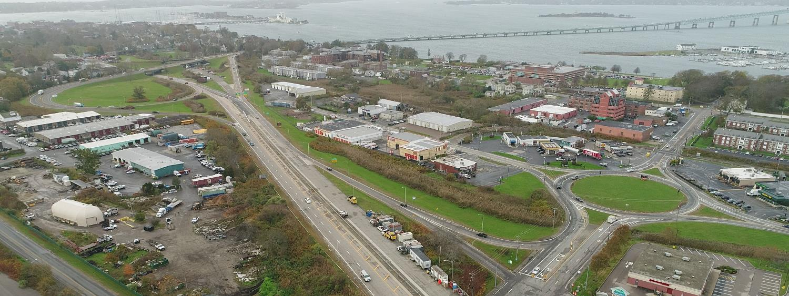
Reconstruction of the Pell Bridge Approaches
Public Workshop
March 1, 2018

Slide 2
Agenda
Project Purpose and Need
Project Components
Project Timeline
Environmental Assessment (EA)
Existing Conditions Evaluation
Public Input
Next Steps

Slide 3
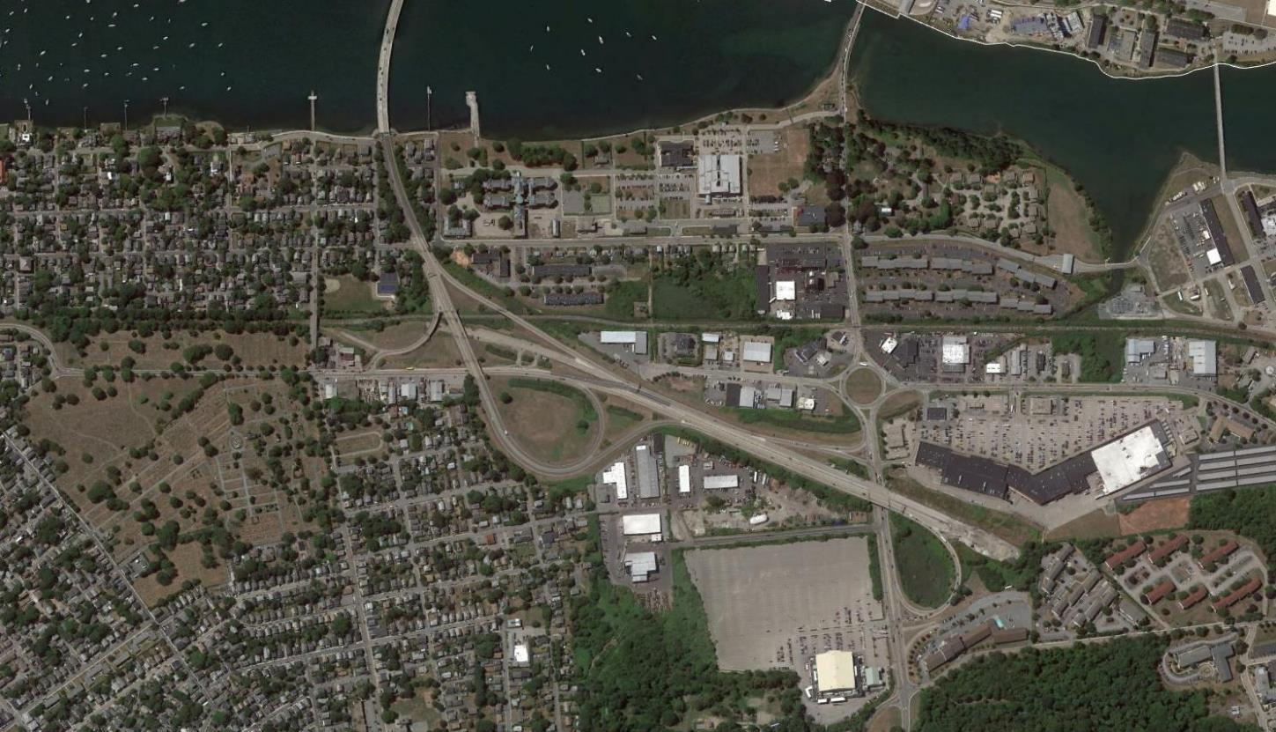
Project Study Area

Slide 4
Project Purpose and Need
Project Purpose
  Improve safety for all road users, including pedestrians, bicyclists, and vehicles
  Create parcels for development
Project Need
  Reduce vehicular congestion and queuing on Pell Bridge
  Improve connectivity between Newport’s North End and Downtown areas for all road users
  Spur economic development – “Innovation Hub”

Slide 5
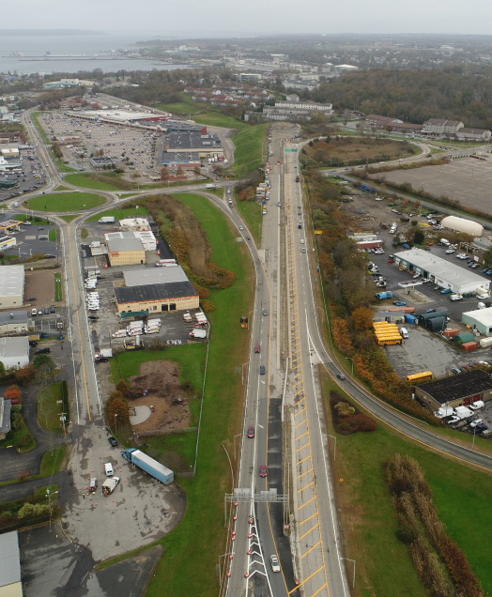
Project Components
Consolidate and remove existing highway infrastructure
Provide connectivity for pedestrians and bicyclists between Admiral Kalbfus Road and America's Cup Avenue along Newport Secondary corridor.
Provide transit connection between Pell Bridge Interchange and Gateway Center

Slide 6
Project Timeline
Existing Conditions Data Collection & Analysis – Summer/Fall 2017
Hold Public Workshop #1 – Early 2018
Develop Alternatives Analysis
Hold Public Workshop #2 – Spring 2018
Submit Draft Environmental Assessment (EA) & 30% Design Plans for FHWA Review & Public Comment – Fall 2018
Submit Final EA – Winter 2018/Early 2019
Obtain a Finding of No Significant Impact from FHWA – Early 2019
Submit Final Design – Spring/Summer 2019
Construction – Winter 2019 thru 2022

Slide 7
Federal Environmental Review Process
Environmental Assessment (EA)
  Identify and evaluate adverse environmental impacts of the Proposed Action, positive or negative
  Identifies the Project’s purpose and need, as well as a reasonable range of alternatives
  Describes mitigation measures, if needed
  Process encourages public review and comment

Slide 8
Examples of Environmental Resources Described and Evaluated
  Wetlands
  Floodplains
  Biodiversity
  Threatened & Endangered Species
  Air Quality
  Land Use
  Environmental Justice
  Socioeconomic Conditions
  Public Health & Safety
  Noise & Vibration
  Transportation
  Cultural Resources
  Parks & Recreation
  Solid & Hazardous Waster
  Greenhouse Gases/Climate Change

Slide 9
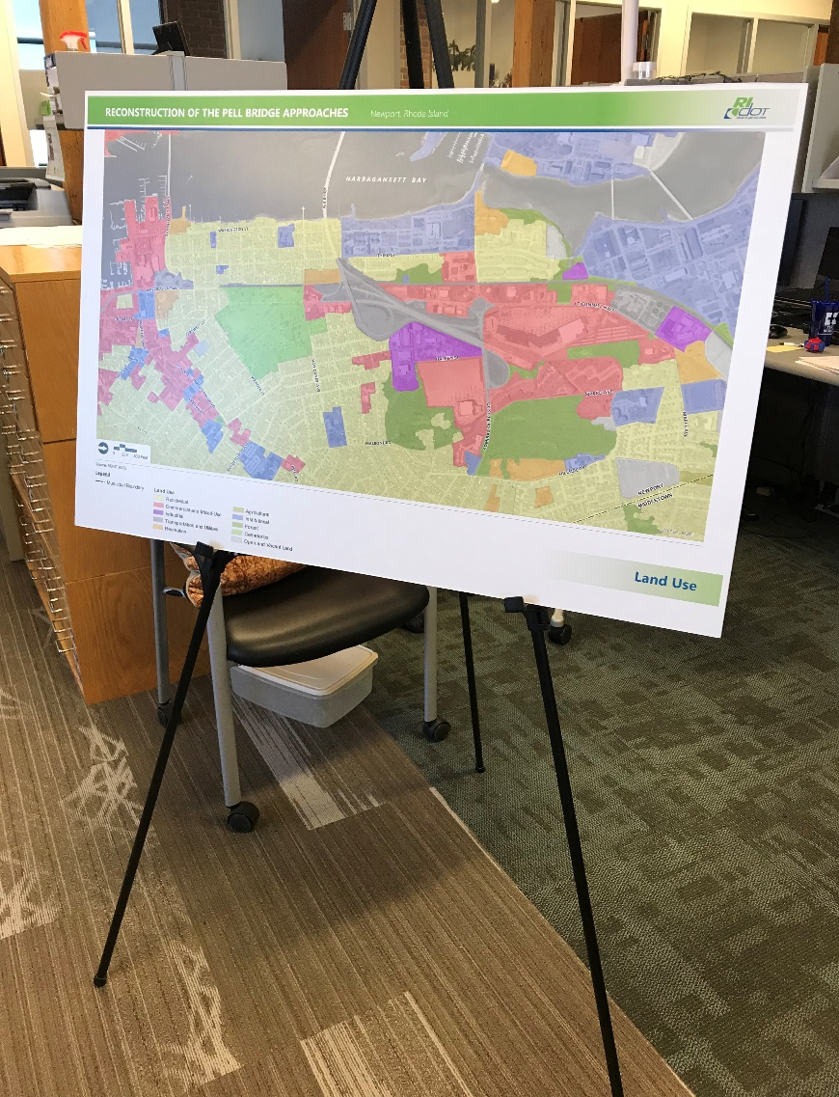
Environmental Resources for Discussion
  Station 1 – EA Process and Schedule
  Station 2 – Land Use & Environmental Justice
  Station 3 – Noise & Community Faculties
  Station 4 – Traffic & Safety
  Station 5- Wetlands & Waterways
  Station 6 – Conservation Areas
  Station 7 – Historic Resources

Slide 10
Public Input
Public input is critical at this stage of the project
  To identify existing issues
  Concerns of the project
Input may be submitted:
  In person tonight – see comment box
  By mail – address provided on the comment form
  Using the online portal – web link provided on the comment form

Slide 11
Next Steps
Submit Draft EA & 30% Design Plans – Fall 2018
Hold Public Workshop #2 – Fall 2018
Final EA – Winter 2018/2019
Submit Final Design – Spring/Summer 2019
Construction – Winter 2019

